Slide 1
OSDU Concepts Demystifying OSDU

Slide 2
Approach
Walk through typically encountered questions
Crossing fingers that “demystifying” does not evolve into “confusing”

Slide 3

Rule of thumb for everything related to…
DON’T
PANIC

Slide 4
What is an OSDU instance?

Slide 5
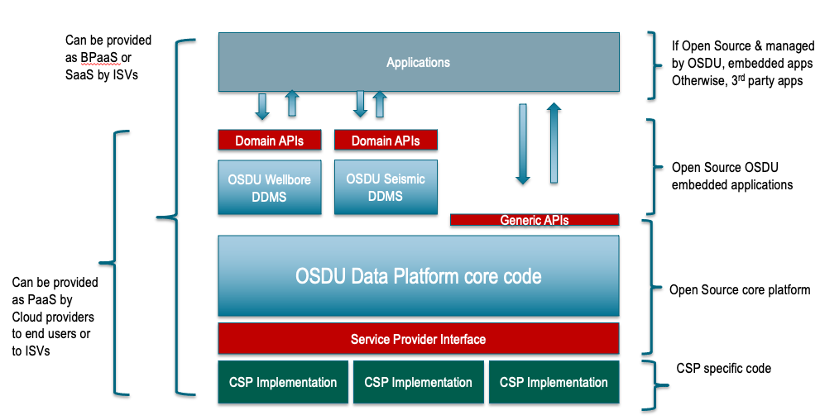
OSDU Data Platform Software Components

Slide 6
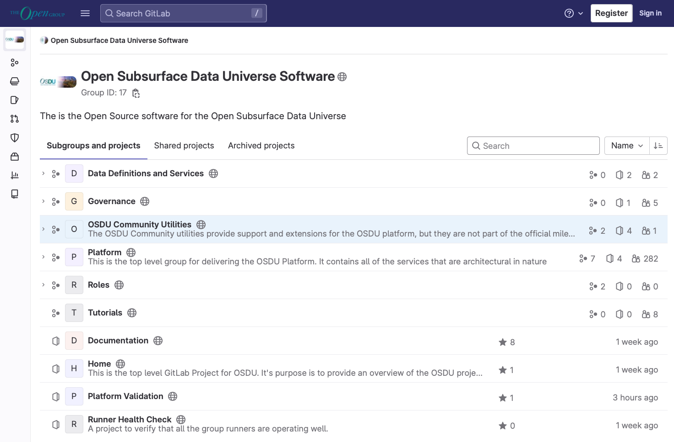
The code…
Platform Code

Slide 7
Demo
Where is the code?
Milestone-concept
Platform Code

Slide 8




Cloud Agnostic

Slide 9
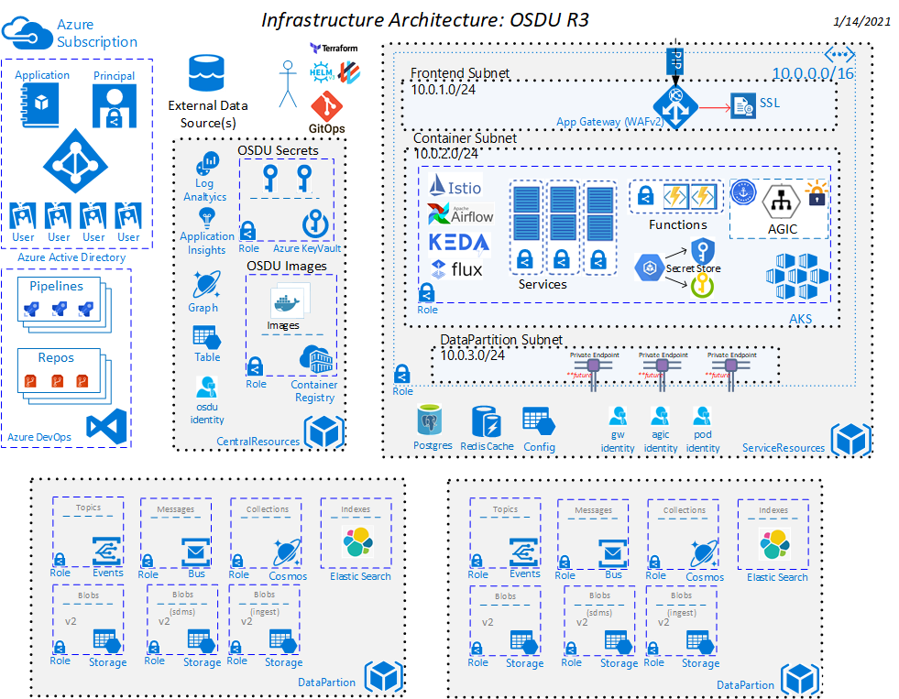
OSDU Behind the scenes

Slide 10
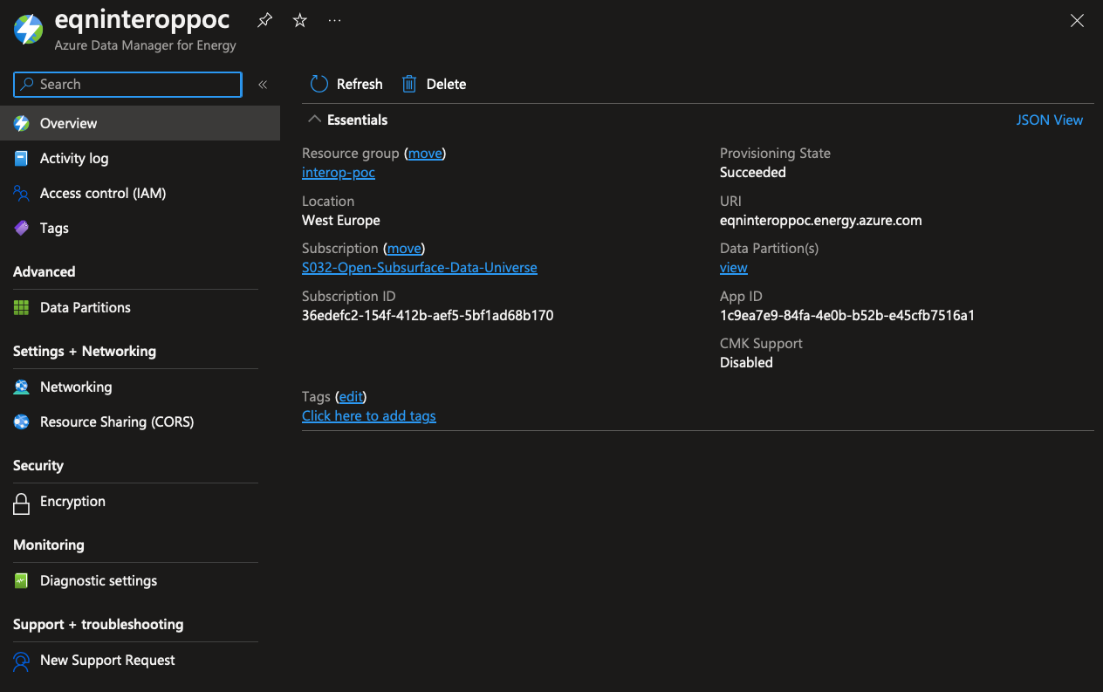
ADME

Slide 11
How can I communicate with my OSDU?

Slide 12
OSDU Data Platform Software Components

Slide 13
APIs only! (for now…?)

Slide 14
Where and how is my data stored?

Slide 15
Two main storages
Catalog
Archive

Slide 16
Two main storages
Catalog
Archive
DocumentDB
BinaryStore

Slide 17
Two main storages
Catalog
Archive
DocumentDB
BinaryStore
JSON
Binaries

Slide 18
Two main storages
File API
Storage API
Dataset API
Catalog
Archive
DocumentDB
BinaryStore
JSON
Binaries

Slide 19
“…main storages…”?

Slide 20
Two main storages
Catalog
Archive

Slide 21
DDMS optimized storage
Reservoir
DDMS
Wellbore
DDMS
Catalog
Archive
Seismic
DDMS

Slide 22
How to form records aka what is Well Known Schemas (WKS)

Slide 23
Data structures
File API
Storage API
Dataset API
Catalog
Archive
DocumentDB
BinaryStore
JSON
Binaries

Slide 24
Data structures
Main data types
Master Data
Work Product Components
Reference Data
Work Product
Dataset
Storage API
Catalog
DocumentDB
JSON

Slide 25
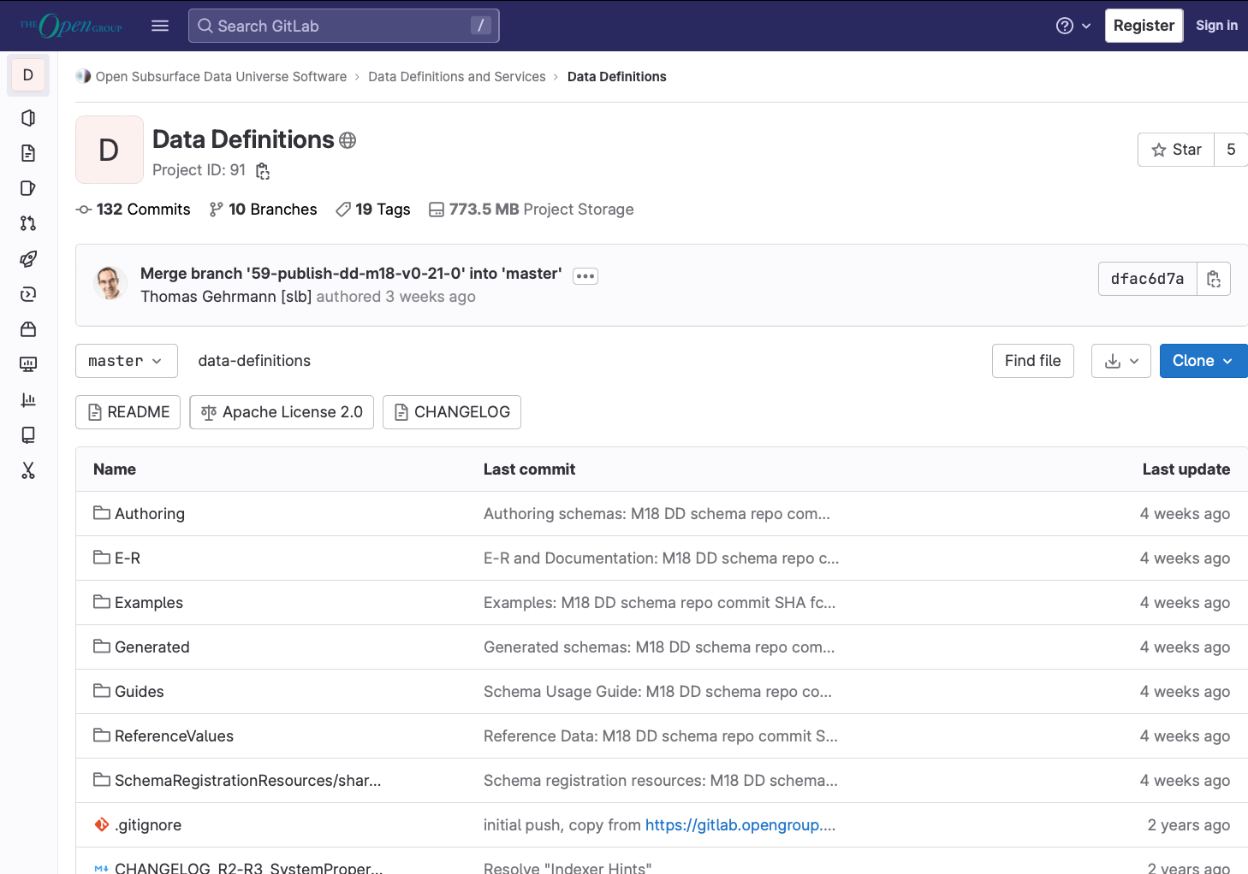
OSDU Data Concepts (prev known as definitions)
OSDU Data Concept

Slide 26
DEMO
Milestone
Schema version
Find schema definition
Rquired and Optional properties
Schema Guideline
OSDU Data Concept

Slide 27
Rule of thumb for everything related to…
DON’T
PANIC

Slide 28
Reference data is a bit special…

Slide 29
OSDU Data Concepts (prev known as definitions)
OSDU Data Concept

Slide 30
DEMO
Fixed, open and local
Multiple instances of reference data sources
OSDU Data Concept

Slide 31
How to define own data structures aka Custom schemas

Slide 32
Your schema in an OSDU wrapper
System resources
Common resources
id
kind
version
acl
acl.owners[]
acl.viewers[]
legal
legal.legaltags[]
legal.otherRelevantDataCountries[]
legal.status
tags
createTime
createUser
modifyTime
modifyUser
ancestry
ancestry.parents[]
meta[]
data
ResourceHomeRegionID
ResourceHostRegionIDs[]
ResourceCurationStatus
ResourceLifecycleStatus
ResourceSecurityClassification
Source
ExistenceKind

Slide 33
Your schema in an OSDU wrapper
System resources
Common resources
id
kind
version
acl
acl.owners[]
acl.viewers[]
legal
legal.legaltags[]
legal.otherRelevantDataCountries[]
legal.status
tags
createTime
createUser
modifyTime
modifyUser
ancestry
ancestry.parents[]
meta[]
data
ResourceHomeRegionID
ResourceHostRegionIDs[]
ResourceCurationStatus
ResourceLifecycleStatus
ResourceSecurityClassification
Source
ExistenceKind
Sample custom schema

Slide 34
To custom or not to custom…
Data type does not exist in WKS
Data type does not have fidelity in WKS
Dependency on other access regimes
Data is not immutable in source
OSDU Data Concept

Slide 35
How do we control access?

Slide 36
Entitlements 101
Connection with IDP
Oauth2 authentication
Does user exist in OSDU user-base?
Does user have authorization to perform <whatever>?
Aka – is user member of the corresponding group?

Slide 37
My groups
Services
Users
service.entitlements.admin
service.entitlements.user
service.legal.admin
service.legal.editor
service.legal.user
service.storage.admin
service.storage.creator
service.storage.viewer
service.schema-service.admin
service.schema-service.editors
service.schema-service.viewers
service.file.editors
service.file.viewers
service.messaging.user
service.search.admin
service.search.user
service.workflow.admin
service.workflow.creator
service.workflow.viewer
service.plugin.user
service.status-publisher.editors
service.status-publisher.viewers
service.dataset.editors
service.dataset.viewers
service.policy.admin
service.policy.user
service.secret.viewer
service.edsdms.user
users
users.data.root
users.datalake.viewers
users.datalake.editors
users.datalake.admins
users.datalake.ops
Data
data.default.viewers
data.default.owners

Slide 38
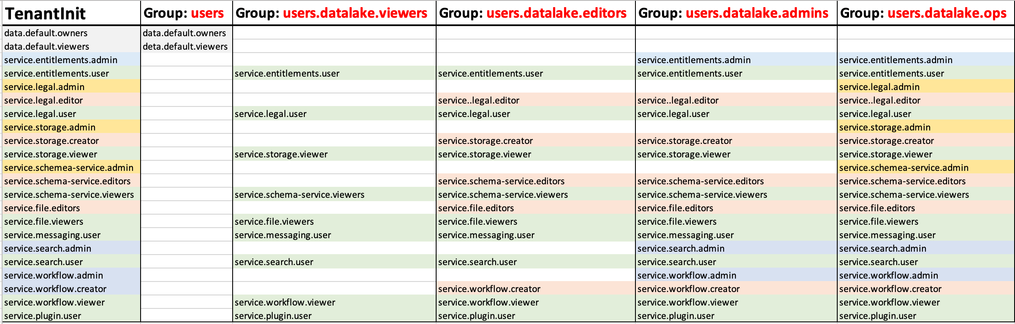
Entitlements

Slide 39
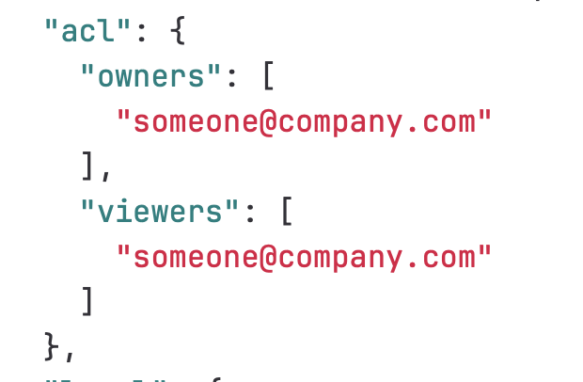
Access to data

Slide 40
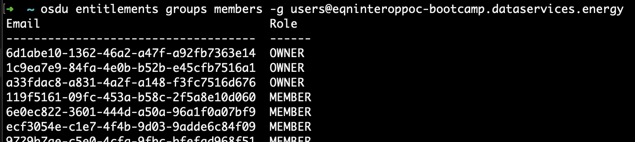
Owners and members

Slide 41
Things to consider
ACL is part of every single record
Keep data group-names as static and close to the data object familiy as possible
Number of data access groups should be as few as possible that covers the needed granularity
Differentiate between users, services and data

Slide 42
To-Be
Policy-engine
Implementation of Open Policy Agent

Slide 43
The Legal Tag…

Slide 44
Legal-tag
{
"name": "eqninteroppoc-bootcamp-bootcamp-private-default",
"description": "A default legaltag to be used for bootcamp data",
"properties": {
"countryOfOrigin": [
"NO"
],
"contractId": "Unknown",
"expirationDate": "9999-12-31",
"originator": "bootcamp",
"dataType": "First Party Data",
"securityClassification": "Private",
"personalData": "No Personal Data",
"exportClassification": "No License Required"
}
}
OSDU Data Concept

Slide 45
Is it possible to do versioning?

Slide 46
Versioning
Milestone-versions
Schema-versions
API-versions
Record-versions
To-be: namespaced record-versions
OSDU Data Concept

Slide 47

API-versioning

Slide 48
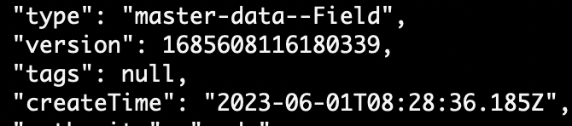
Record-versioning

Slide 49
When to…
Create new version of a record
vs
Create new instance of a record
OSDU Data Concept

Slide 50
What about tracing lineage?

Slide 51
Lineage
Ancestry
Lineage assertion
Source
Dataset
Activity-model
Versioning
OSDU Data Concept

Slide 52
How can I find my data?

Slide 53
Indexer and search
Elasticsearch
Indexer-hints
Extension properties
(to-be) Custom indexing

Slide 54
We got the tools, how do we ingest?

Slide 55
Write data records
File
Workflow
Storage
DDMS

Slide 56
How is it meant to be used?

Slide 57
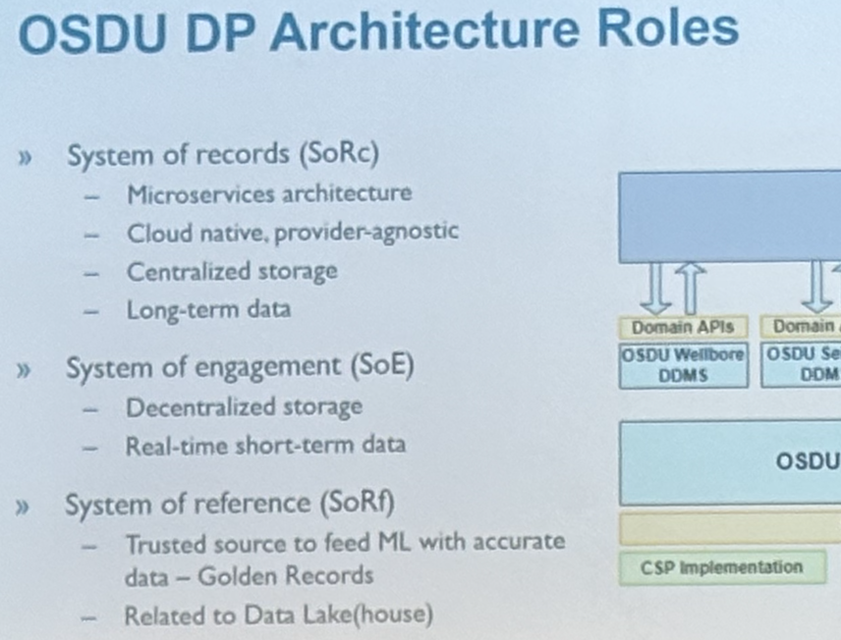

Slide 58
Rule of thumb for everything related to…
DON’T
PANIC

Slide 59
Questions?

